Slide 1
Visual QA
2018.12.26
김정원

Slide 2
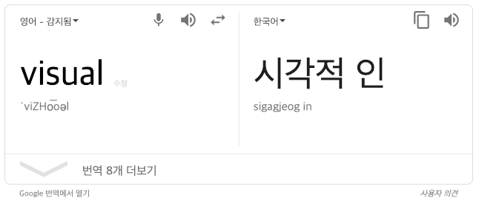
Visual QA

Slide 3
Visual QA
Visual(시각적인)
보여지는 무언가가 주어지고
Q: Question
질문에 대해서
A: Answering
답을 해야함

Slide 4
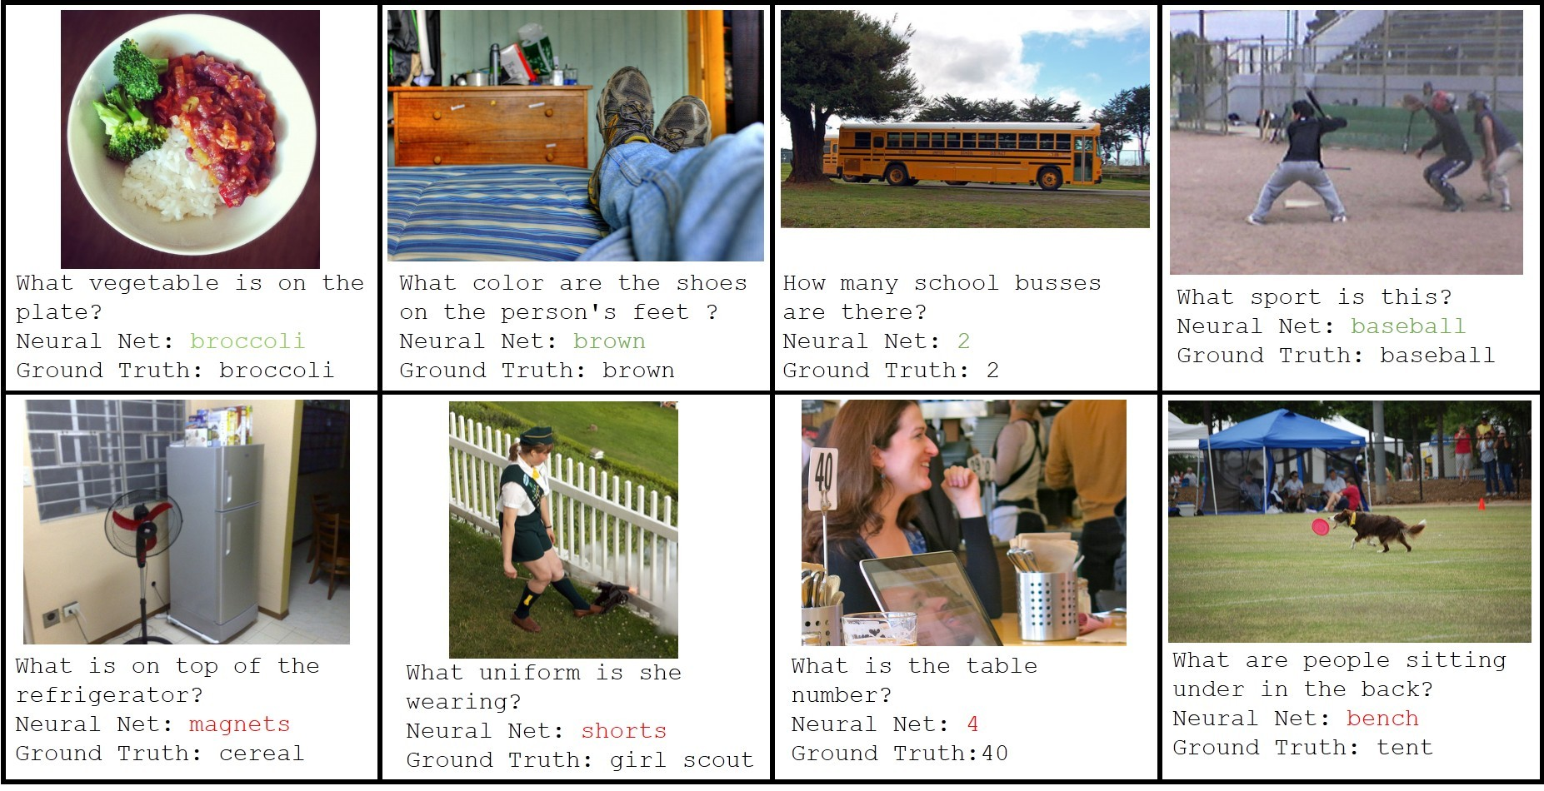
Visual QA

Slide 5
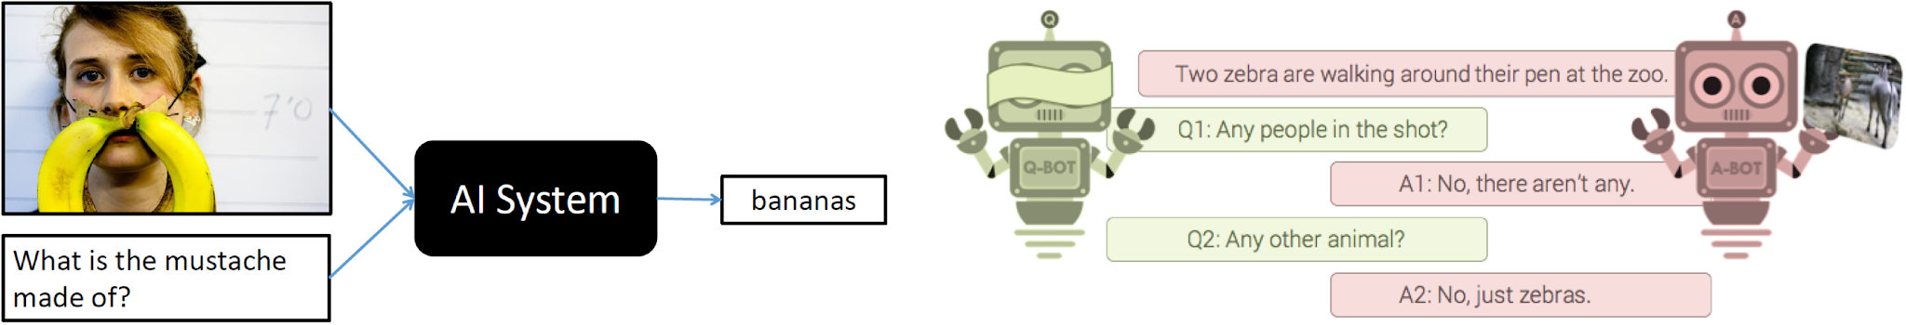
VQA Dataset - v1

Slide 6
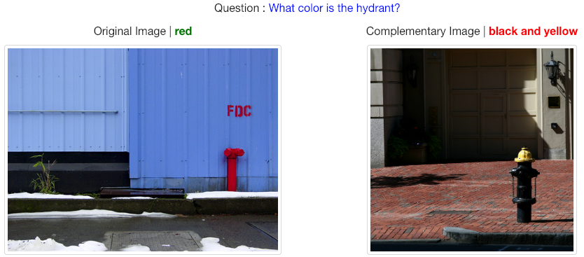
VQA Dataset - v2

Slide 7
VQA for what?
어떤 문제에 대해 답변을 해야할까?
이미지에 대해 질문 가능한 거의 대부분의 문제를 해결하고자 함

Slide 8
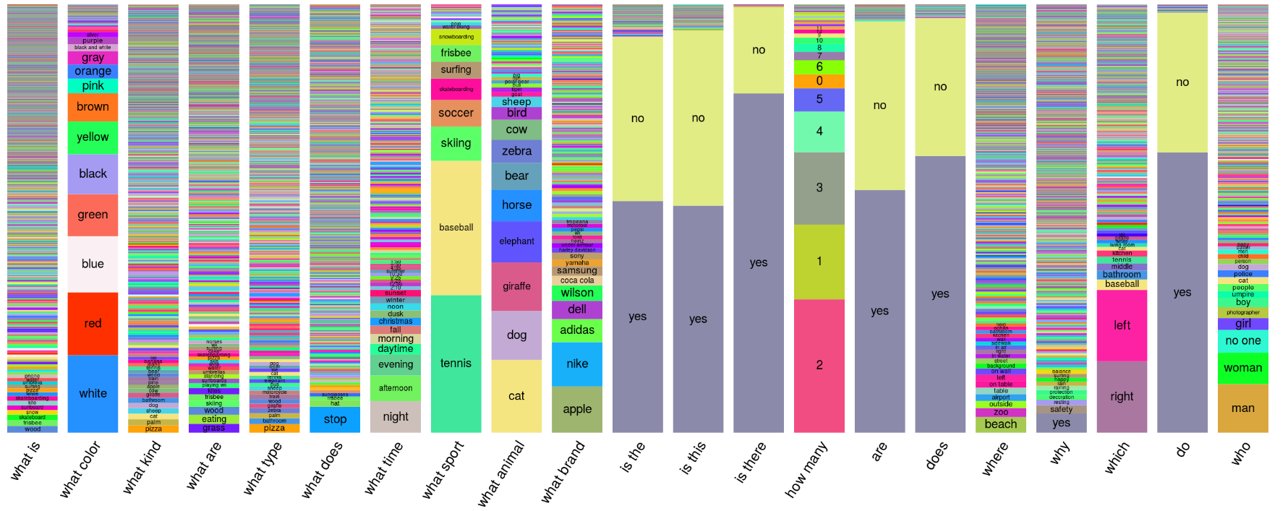
VQA Answer Distribution - v1

Slide 9
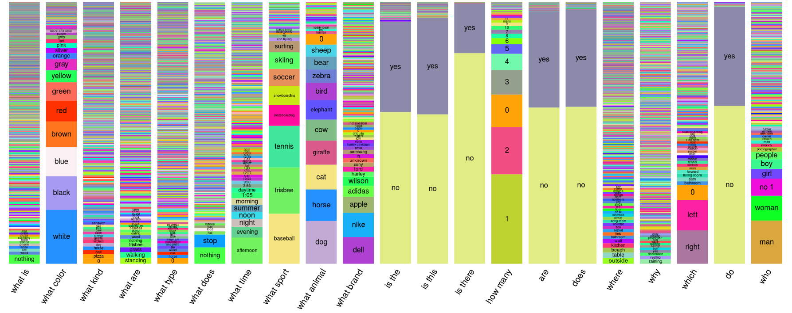
VQA Answer Distribution - v2

Slide 10
Sub-problems
Classification with Complex Setting
Multi-domain classification
What is this? / What is she doing?
Classification with input/output connection
Is this …? (Yes / No)
Zero-shot learning
Training: Cat, Test: ‘Is this kittie?’

Slide 11
Sub-problems
Novel Computer Vision Tasks
Reference problem
What color is the …?
Spatial relation problem
What is behind the …?
Visual semantic role labeling [Gupta et al., 2015]
What is the man …ing?
Weakly-supervised learning to count
How many …?

Slide 12
Sub-problems
Data Efficiency Problem
Operation compositionality
Image QA task compositionality
What the man on the horse is doing?

Slide 13
Sub-problems
Natural Language Understanding
Extracting operation and inputs from question
What is required information for each tasks?

Slide 14
Papers
DPPNet
Image Question Answering using Convolutional Neural Network with Dynamic Parameter Prediction
Dynamic Parameter Prediction Network
https://arxiv.org/pdf/1511.05756.pdf
MCB Pooling
Multimodal Compact Bilinear Pooling for Visual Question Answering
Hashing Trick & FFT/Inv-FFT
https://arxiv.org/pdf/1606.01847.pdf

Slide 15
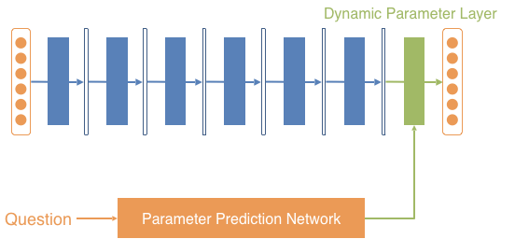
DPPNet

Slide 16
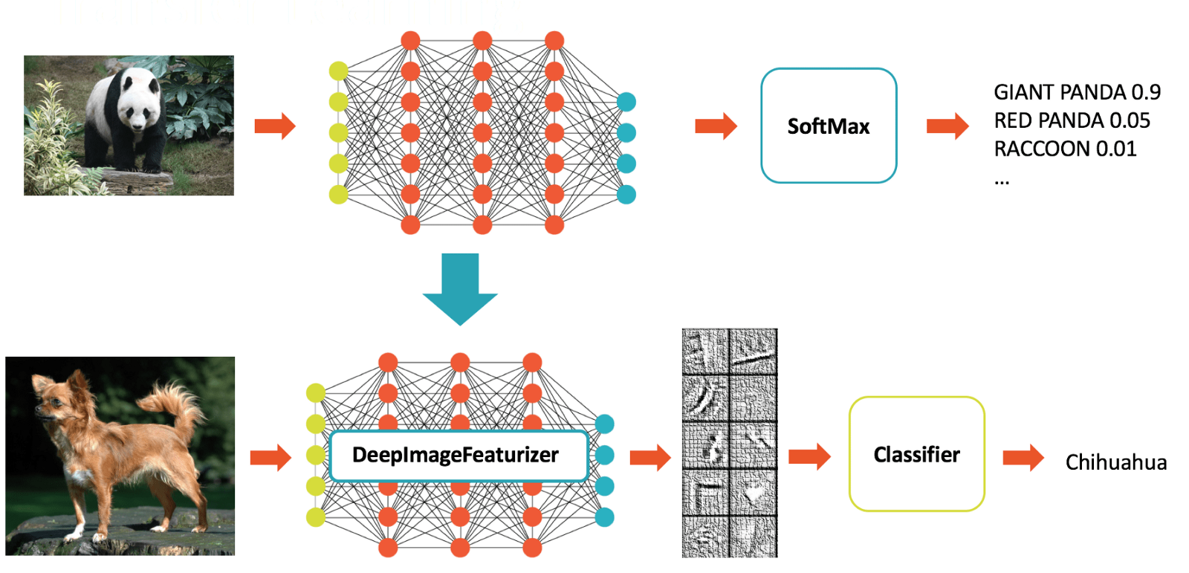
Transfer Learning - Parameter initialization (INIT)

Slide 17
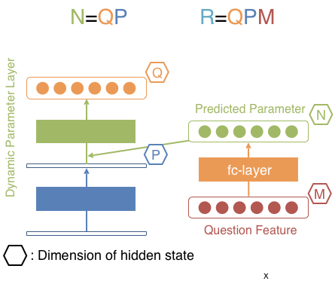
DPPNet
Parameter Explosion
Parameter 교체 모델
For example…
Q=1000
P=1000
M=500
N = QP = 1,000,000
R = 500,000,000 (= 1.86GB for single layer) (VGG19 Params: 144,000,000)

Slide 18
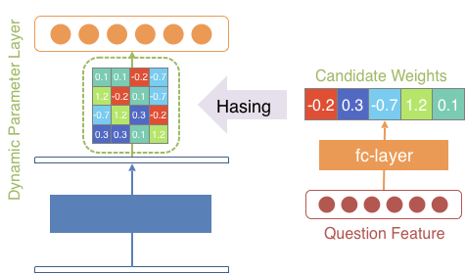
Weight Sharing with Hashing Trick
[Chen et al., 2015]

Slide 19
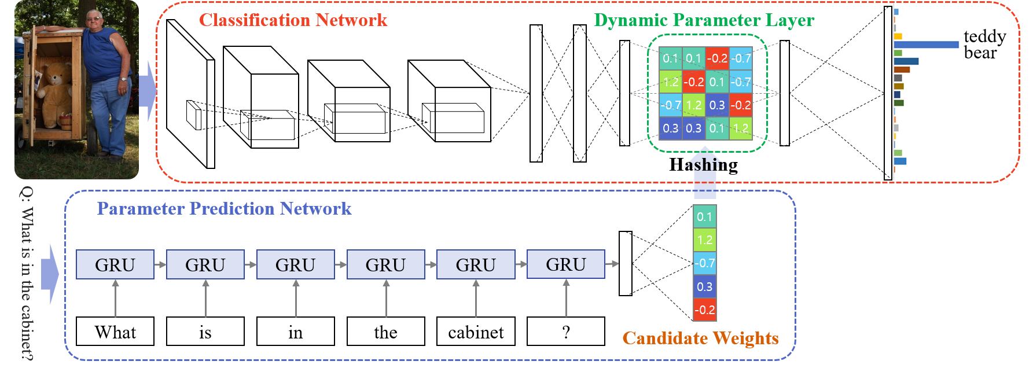
DPPNet

Slide 20
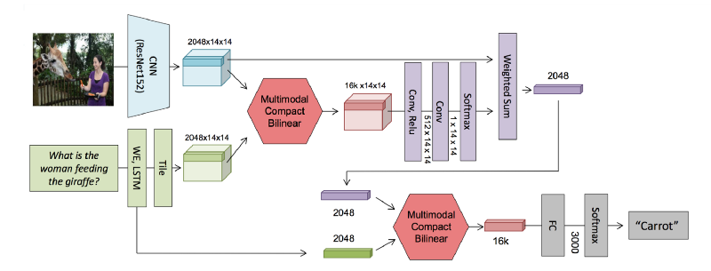
MCB Pooling

Slide 21
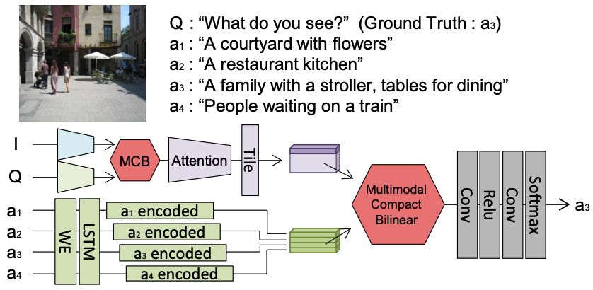
MCB with Attention

Slide 22
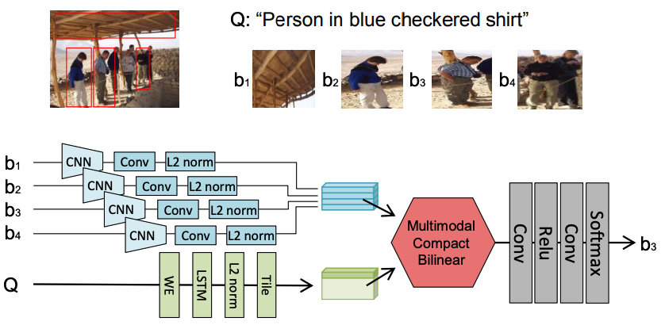
Grounding with MCB

Slide 23
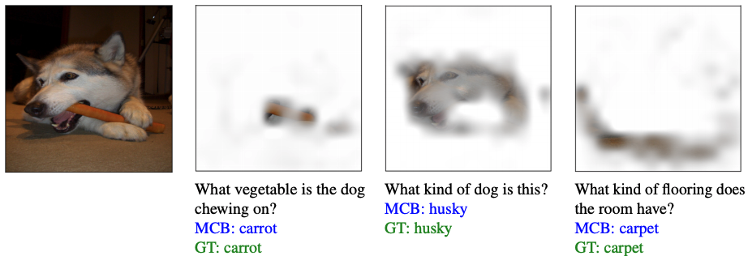
MCB Pooling

Slide 24
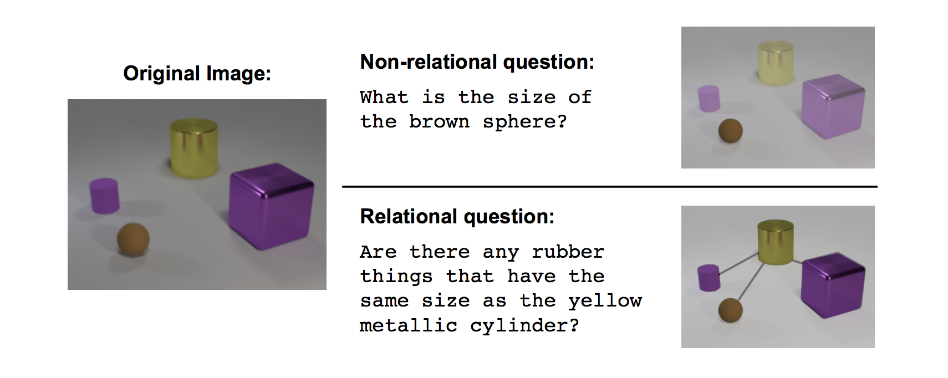
Extra Work
Relational Network (RN)
Visual QA 문제에서 관계형 추론(relational reasoning)을 도출하고자 DeepMind가 제안한 신경망 모델
논문 링크: https://arxiv.org/pdf/1706.01427.pdf

Slide 25
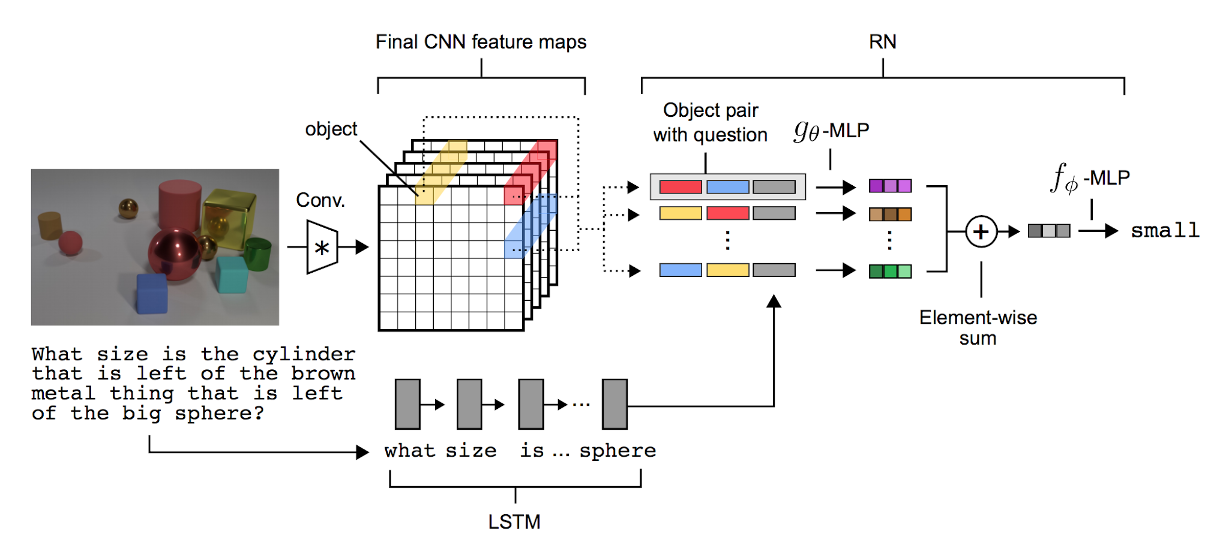
Extras

